Slide 1

Limitless horizon
Web application
Aishwarya Jaiswal
Ishan sethi

Slide 2
LIMITLESS HORIZON
Web-App is a supportive tool for classroom activities. It has multiple in-build features that assist teachers and is a friendly platform for the students. The platform is a combination of 3 tools.
Book Recommendation System.
Text Summarizer.
Drowsiness Detection.
Students, as well as teachers, can use the book recommender.
Moreover, the text summarizer will help students learn things quickly &, on the other side, will help teachers check exam sheets at a good pace.
Then comes drowsiness detection; the teachers can use it to keep an eye on the students while the lecture is going.

Slide 3

Book Recommendation
If we plan to buy any new product, we usually ask our friends, research the product features, compare the product with similar products, read the product reviews on the internet, and then we make our decision.
How convenient if all this process was taken care of automatically and recommend the product efficiently?
A recommendation engine or recommender system is the answer to this question.

Slide 4
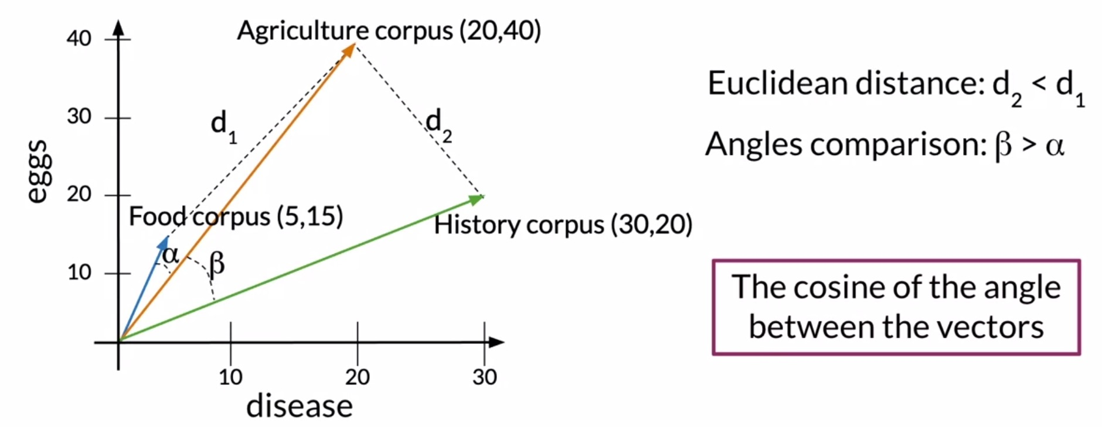

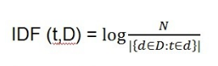

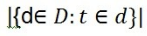
Book Recommendation
TF – IDF
Well cosine similarity is a measure of similarity between two non zero vectors. One of the beautiful thing about vector representation is we can now see how closely related two sentence are based on what angles their respective vectors make.
Cosine value ranges from -1 to 1.
So if two vectors make an angle 0, then cosine value would be 1, which in turn would mean that the sentences are closely related to each other.
The fundamental idea is to convert the texts or words into a vector and represent in a vector space model.
TF- IDF stands for Term Frequency and Inverse Document Frequency .TF-IDF helps in evaluating importance of a word in a document.
Where N is the total number of documents in the collection & is the number of documents where term t is present
Cosine Similarity

Slide 5
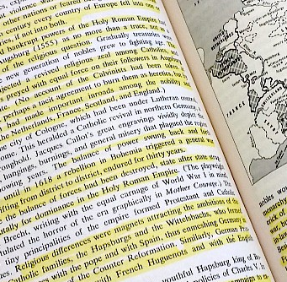
Text Summarizer
Automatic text summarization, or just text summarization, is the process of creating a short and coherent version of a longer document.
Text summarization is the process of distilling the most important information from a source (or sources) to produce an abridged version for a particular user (or users) and task (or tasks).
It is the task of producing a concise and fluent summary while preserving key information content and overall meaning

Slide 6
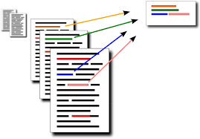


Text summarizer
Tokenization
Stop words
Tokenization is the process by which big quantity of text is divided into smaller parts called tokens.
These tokens are very useful for finding such patterns as well as is considered as a base step for stemming and lemmatization.
Tasks such as Text classification or spam filtering makes use of NLP along with deep learning libraries.
A stop word is a commonly used word (such as “the”, “a”, “an”, “in”) that a search engine has been programmed to ignore, both when indexing entries for searching and when retrieving them as the result of a search query.
Sample text with Stop Words | Without Stop Words
Can listening be exhausting? | Listening, exhausting
I like reading, so I read | Like, reading, read

Slide 7

Drowsiness detection
Drowsiness Detection is a safety technology that not only help prevent accidents on roads that are caused by driver falling asleep while driving but also, can be used in classroom.
The objective is to build a drowsiness detection system that will detect that a student’s eyes are closed for a few seconds. This system will alert the teacher when drowsiness is detected.

Slide 8
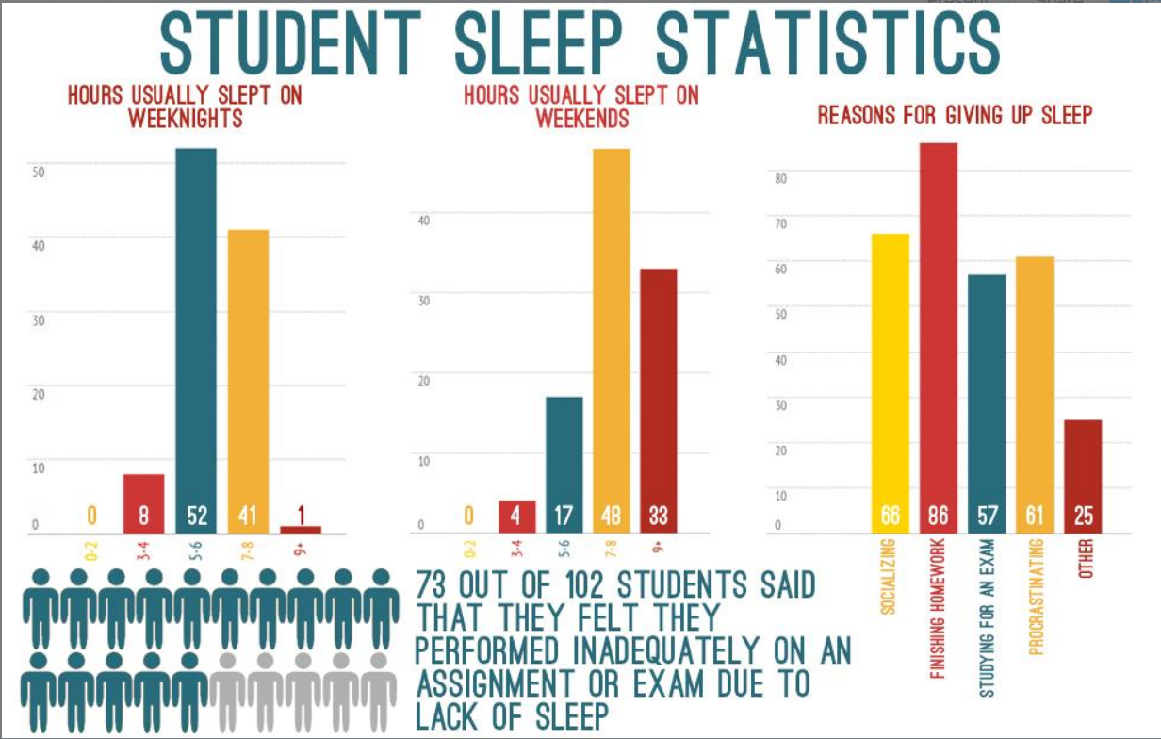
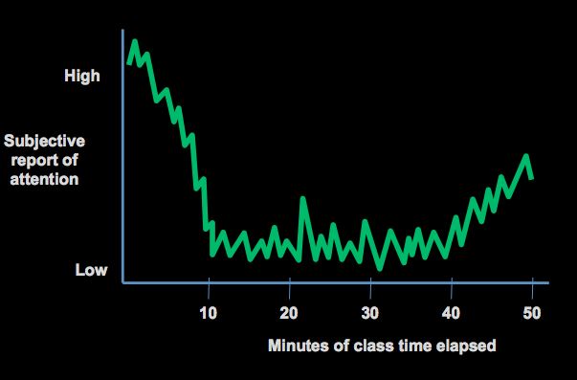
Drowsiness detection Stats
The data shows that student attention level takes a dive, approximately 10 minutes into a lesson. The problem is that so many instructors see instructing as a one-way communication. If a student is not contributing to the communication, they lose focus and many literally go to sleep.
This is a graph demonstrating the basics of a students sleep schedule. The students are not getting enough sleep on an average school day, and the reasons why this is happening is depicted in the graph above.

Slide 9

Drowsiness detection
The CNN model architecture consists of the following layers:
Convolutional layer; 32 nodes, kernel size 3
Convolutional layer; 32 nodes, kernel size 3
Convolutional layer; 64 nodes, kernel size 3
Fully connected layer; 128 nodes
The final layer is also a fully connected layer with 2 nodes. In all the layers, a Relu activation function is used.
Notes:
1 Convolution layer = Conv2D+MaxPooling2D
Convolution + Pooling layer = 1 Convolution layer

Slide 10
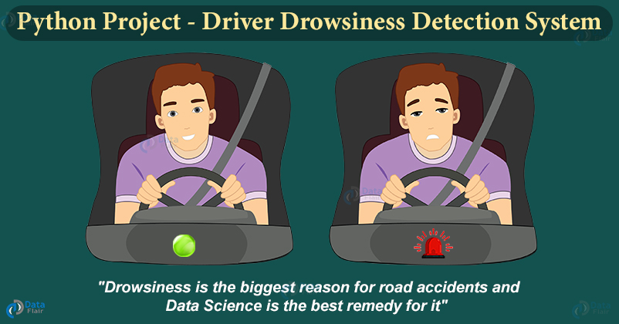
Drowsiness detection
Step 1 – Take image as input from a camera.
Step 2 – Detect the face in the image and create a Region of Interest (ROI).
Step 3 – Detect the eyes from ROI and feed it to the classifier.
Step 4 – Classifier will categorize whether eyes are open or closed.
Step 5 – Calculate score to check whether the person is drowsy.

Slide 11


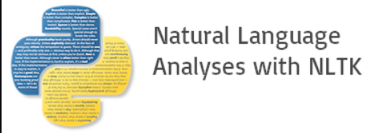

Technologies Used
Flask
Keras
NLTK
OpenCV
Flask is a micro web framework written in Python. It is classified as a microframework because it does not require particular tools or libraries.
Keras is an open-source library that provides a Python interface for artificial neural networks. Keras acts as an interface for the TensorFlow library.
The Natural Language Toolkit, or more commonly NLTK, is a suite of libraries and programs for symbolic and statistical natural language processing for English written in the Python programming language.
Computer vision is an interdisciplinary scientific field that deals with how computers can gain high-level understanding from digital images or videos.

Slide 12
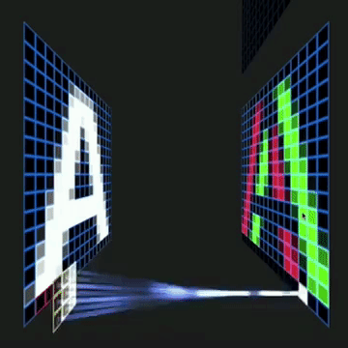
Thank you
Ishanblaster1000@gmail.com
https://www.linkedin.com/in/ishansethi09/

